Slide 1
Indicators for heavy traffic on I-94 Highway, Minnesota
A Project Summary by Sai Prithvi

Slide 2
Project Overview
This project applies EDA (Exploratory Data Analysis) on the I-94 Minnesota Highway Dataset for Westbound traffic to find factors and indicators that contribute to Heavy Traffic using various python libraries.
Objective
To use exploratory data visualization to identify the primary factors contributing to heavy westbound traffic on I-94 based on weather, time, and day of week indicators.
Tools Used
Python Packages: Pandas, Seaborn and Matplotlib
*Courtesy of the UCI Machine Learning Repository, John Hogue who made the dataset available for use.*

Slide 3
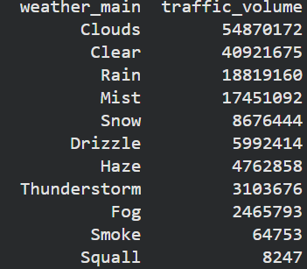
Data Manipulation
There were a total of 48204 entries in the dataset.
Converted date_time to datetime64 dtype
Converted Kelvin to Celsius
Changed all ‘None’ values in holiday column to ‘normal_day’
Discovered 17 duplicate values and removed them, Leaving 48,187 entries left.
Grouped weather data by traffic volume and found out traffic volume is highest during cloudy or clear weather by a significant amount.

Slide 4
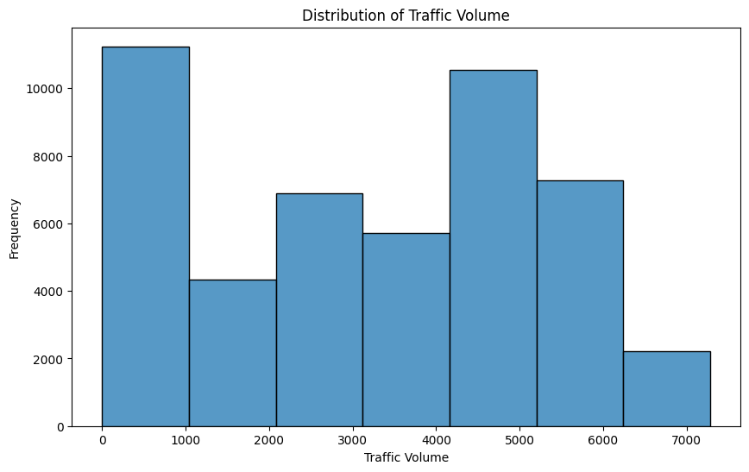
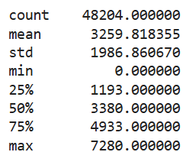
Analyzing Traffic Volume Distribution
After observing the histogram for distribution of traffic volume, We can confirm that the most frequent traffic density is between 0-1000 and 4000-5000 vehicles approximately.
There is an average of 3280 vehicles as the traffic volume with the maximum vehicles being 7280 vehicles in a single hour.

Slide 5
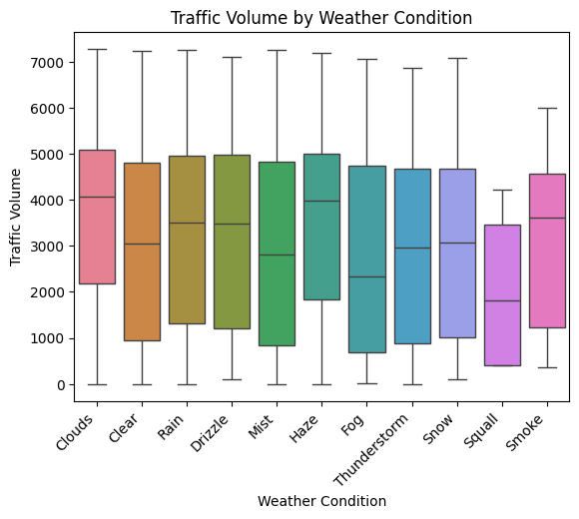
Analyzing Traffic Volume Distribution by Weather Conditions
After observing the boxplot distribution of traffic volume based on weather, The median for Cloudy, Haze, Rain/Drizzle and Smoke are higher than the rest signifying high density of traffic under those specific conditions.
The median for Fog, Mist and Squall is lower than the rest meaning traffic density is lower for those specific conditions.This could be due to less people risking driving on the roads during low visibility.

Slide 6
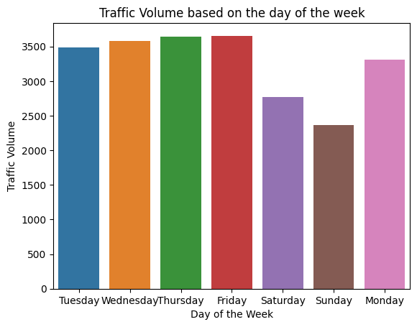
Analyzing Traffic Volume Distribution by Day of Week
After observing the barplot distribution of traffic volume based on the day of the week, Saturday and Sunday are discovered to be the days with the lowest traffic volume, likely due to it being the weekend and most of the population having their days’ off.

Slide 7
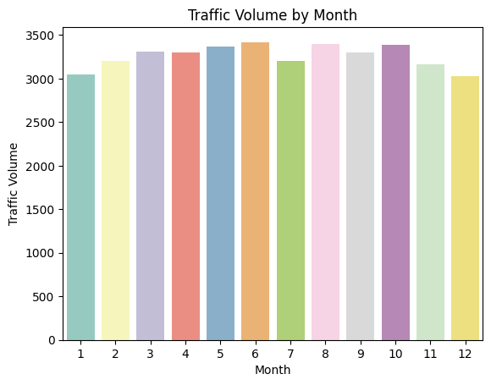
Analyzing Traffic Volume Distribution by Month
From the bar graph for traffic volume versus each month, Winter months from November to February are observed to have the lowest traffic volume, most likely due to winter holidays.
Summer months from June to August have the highest traffic volume except for July which seems unusual.

Slide 8
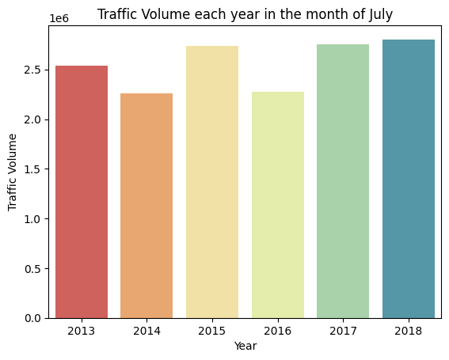
Analyzing yearly Traffic Volume Distribution in the month of July
Judging from the bar graph below for the traffic density for each year in the month of July, we can observe that 2016 and 2014 have significantly lower traffic density which is the reason behind July having lower traffic volume in the Summer months. This could be because of road construction work or the road being closed down for other reasons.

Slide 9
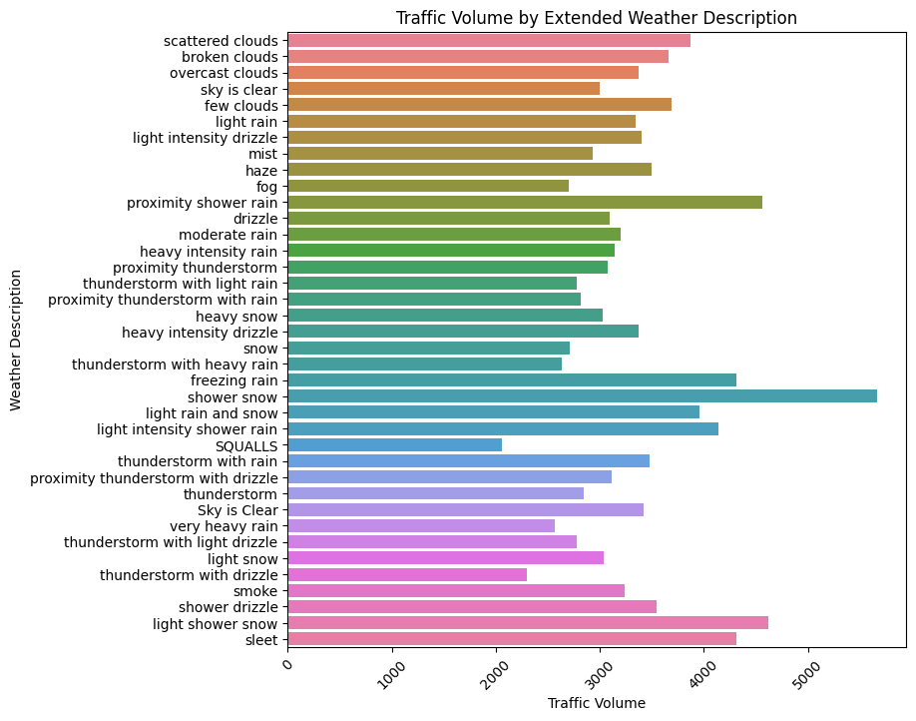
Analyzing Traffic Volume Distribution by weather details
From the bar graph with the detailed weather description, we can infer that any form of rain or snow causes a decent spike in traffic volume.
Shower snow and proximity shower rain in particular have the highest observed traffic density.
This could be due to slower driving speeds causing more congestions and more people preferring to go by car to avoid walking or biking/cycling.

Slide 10
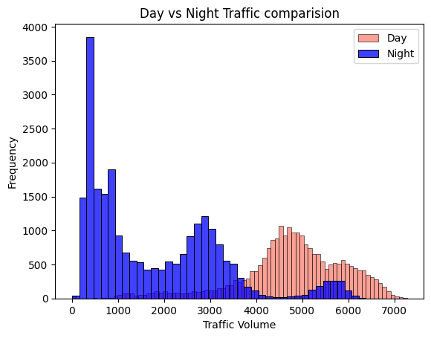
Comparing Day vs Night Traffic Volume Distribution
Judging from the histogram below and comparing the day vs night traffic densities, we can observe that night traffic is significantly lower than day traffic which is to be expected as most individuals are back home from work or asleep.
There are some exceptions for traffic density during nighttime which needs to be investigated.

Slide 11
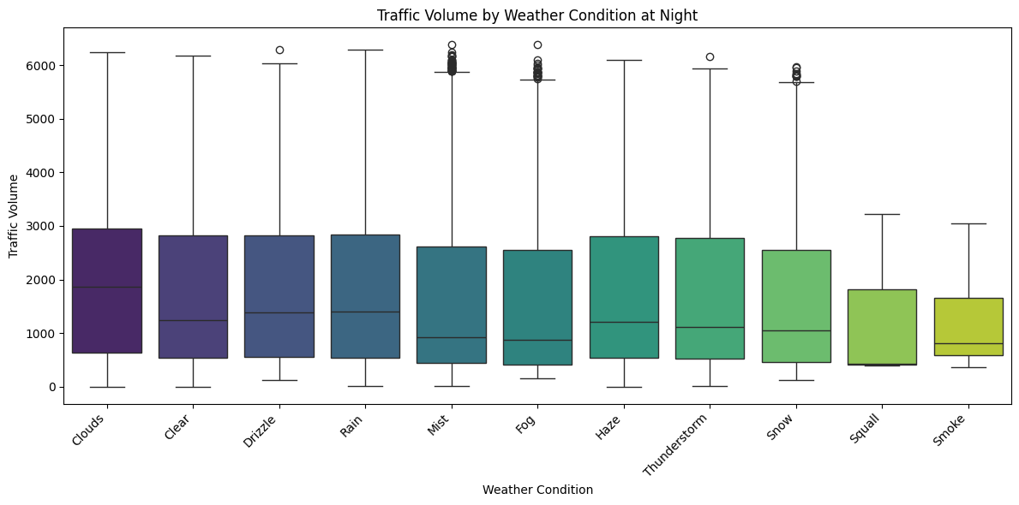
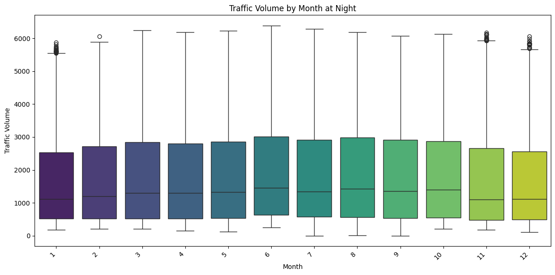
Analyzing traffic volume distribution by weather condition at night
From the boxplot below we can see that most of the outliers (black circles at the top of the plots) with high traffic density during the night are appearing during fog,mist and snow. This hypothesis is further confirmed when we check by month to see the outliers appearing during the winter months.

Slide 12
Conclusion
In this project, A thorough exploratory data analysis was conducted using python libraries such as pandas, seaborn and matplotlib.
Many tasks such as data cleaning, manipulation, sorting and visualizing were done to discover a few indicators of heavy traffic on the I-94 Interstate highway.
Here are a list of key insights discovered for traffic on the I-94:
Weather conditons that are light in severity such as drizzle,haze or smoke increases traffic volume significantly. Harsh weather conditions such as shower snow or thunderstorms on the other hand tend to show the opposite.
Normal workdays from Mon-Fri tend to have more traffic than weekends or holidays.
Road closures or construction work tend to significantly reduce the volume of traffic. (July had road construction work in 2016)
Summer months tend to cause heavy traffic flow compared to winter months.
Daytime tends to have more traffic than nighttime with some exceptions discovered for night.
The causes for heavy traffic in the night are discovered to be fog, mist or snow.

